Slide 1

Applied Physics For Engineers
(PHY-121)
CIIT, Attock
Lecture 02: Scientific and Engineering Notation

Slide 2
CIIT, Attock
Scientific and Engineering Notation
Objectives
To show how very large or very small numbers can be expressed in scientific notation (OR in power of 10!)

Slide 3
Scientific Notation
CIIT, Attock
Very large or very small numbers can be expressed using scientific notation
  The number is written as a number between 1 and 10 multiplied by 10 raised to a power.
  e.g. 7200 is 7.2 x 10³
  The power of 10 depends on:
    The number of places the decimal point is moved.
    The direction the decimal point is moved.
Left ⇒ Positive exponent
Right ⇒ Negative exponent

Slide 4
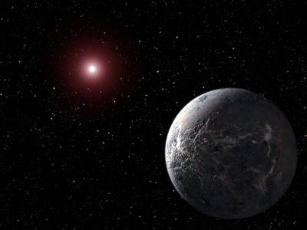
Scientific Notation
CIIT, Attock
Representing Large Numbers
93,000,000 miles from the Earth to the Sun (sunlight takes 8 minutes to reach us)
93,000,000 = 9.3 x 10,000,000
= 9.3 x 10 x 10 x 10 x 10 x 10 x 10 x 10
= 9.3 x 10⁷ (Decimal point moved 7 digits to the left)
Number between 1 and 10
Appropriate power of ten

Slide 5
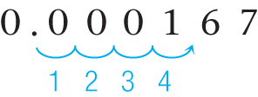
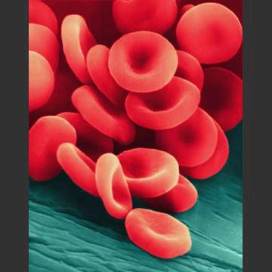
Scientific Notation
CIIT, Attock
Representing Small Numbers
  0.000167
  To obtain a number between 1 and 10 we must move the decimal point to the right.
0.000167 = 1.67 × 10⁻⁴
10⁻⁴ = 1/10000 (one ten-thousandth)

Slide 6
Convert the following numbers between normal and scientific notation:
CIIT, Attock
329
700,000
20090
0.000034
0.01023
123.4
45.607
1.7 x 10³
2.4503 x 10⁵
7.9 x 10⁸
2.8 x 10⁻³
7.45 x 10⁻¹
2.3 x 10⁻⁷

Slide 7
Convert the following numbers between normal and scientific notation:
CIIT, Attock
329 3.29x10^2
700,000 7x10^5
20090 20.090x10^3
0.000034 3.4x10^-5
0.01023 10.23x10^-3
123.4 12.34x10^1
45.607 4560.7x10^-2
1.7 x 10³ ¹⁷⁰⁰
2.4503 x 10⁵ ²⁴⁵⁰³⁰
7.9 x 10⁸ ⁷⁹⁰⁰⁰⁰⁰⁰⁰
2.8 x 10^{-3 .0028}
7.45 x 10^{-1 0.745}
2.3 x 10^{-7 0.0000023}

Slide 8
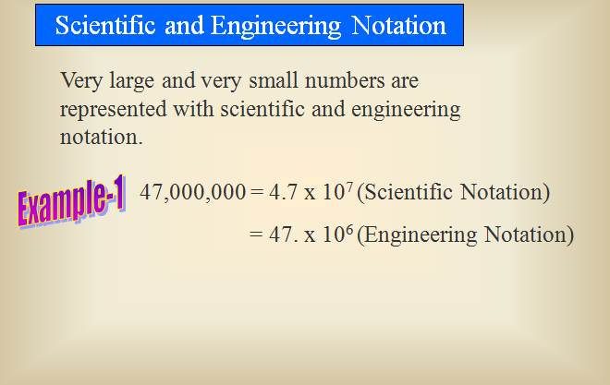
CIIT, Attock

Slide 9
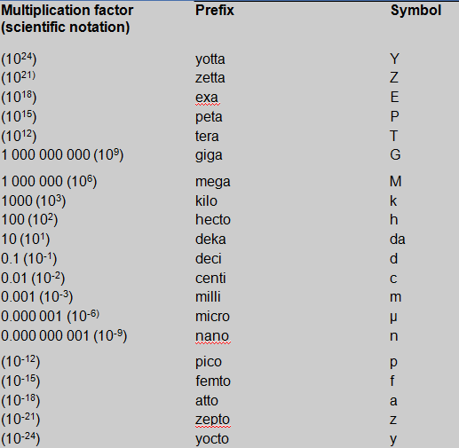
Prefixes used for Engineering notations
CIIT, Attock

Slide 10
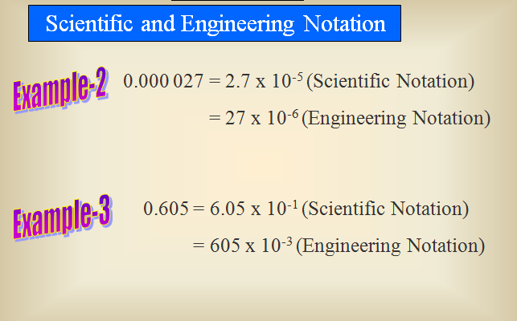
CIIT, Attock

Slide 11
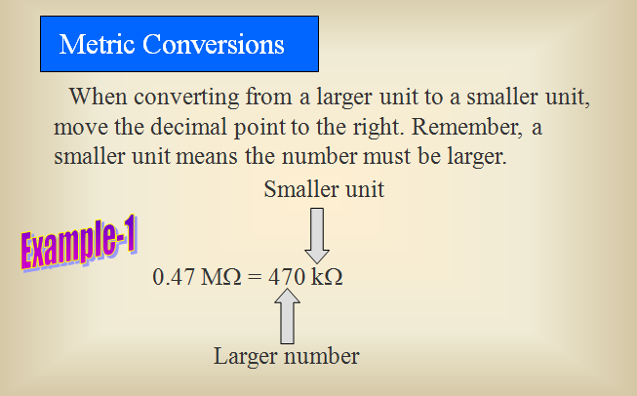
CIIT, Attock

Slide 12
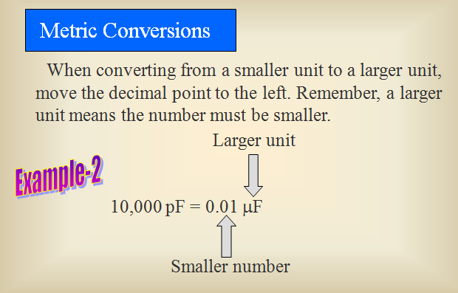
CIIT, Attock

Slide 13
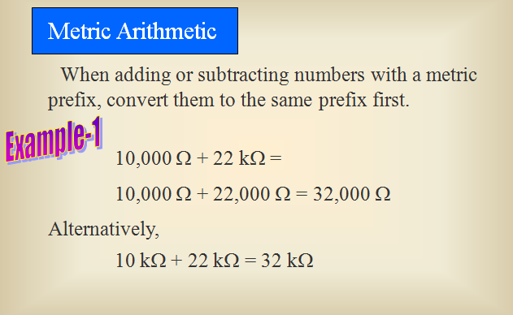
CIIT, Attock

Slide 14
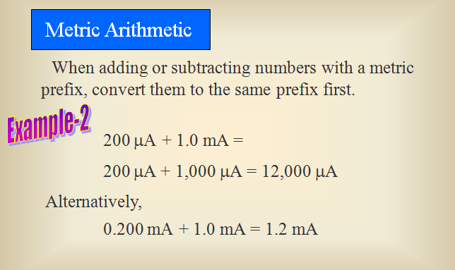
CIIT, Attock

Slide 15
Practice
0.0065 km -→ meters
1750000 micro volts ----→ kilo volts
5.02 x 10^3 pico seconds -> nano seconds
3800 cm^2 -→ m^2
1.84 in^3 → cm^3 → m^3 [hint: 1in=2.54cm , 1m=100cm]
763 mi/h → m/s { 1 mi=1.609KM }

Slide 16
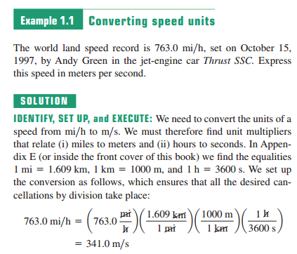
Unit consistency and conversions
An equation must be dimensionally consistent. Terms to be added or equated must always have the same units. (Be sure you’re adding “apples to apples.”)
Always carry units through calculations.

Slide 17
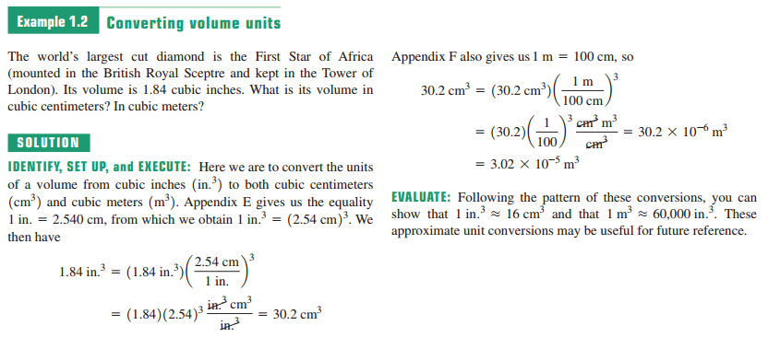

Slide 18
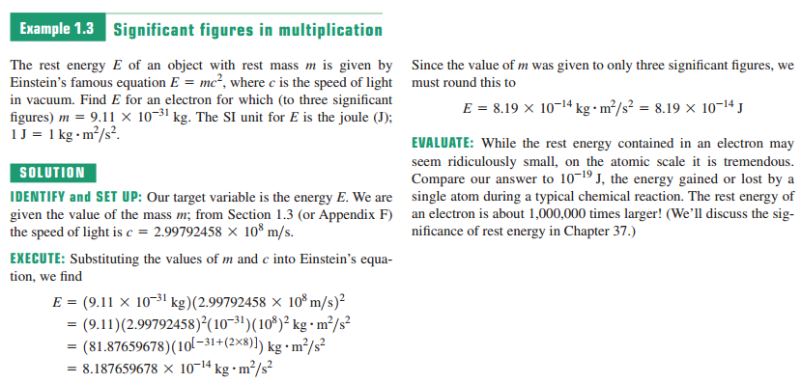

Slide 19
Significant Figures
CIIT, Attock
The number of significant digits in a number is the number of digits used to express it.
The more sig: digits used to express measured quantity the greater the Precision of that measurement.
3050. has 4 sig. figs.

Slide 20
Rules for Counting Significant Figures
CIIT, Attock
Nonzero integers are always significant
Zeros
  Leading zeros never count as significant figures
  Captive zeros are always significant
  Trailing zeros are significant if the number has a decimal point.

Slide 21
CIIT, Attock
  Nonzero integers always count as significant figures.
  3456 has
  4 sig. figs.
  Zeros
  Captive zeros always count as significant figures.
  16.07 has
  4 sig. figs.
  Trailing zeros are significant only if the number contains a decimal point.
  9.300 has 4 sig. Figs.
  3050 has 3 sig. Figs.
  3050. has 4 sig. figs.

Slide 22
Multiplication/Division with Significant Figures
CIIT, Attock
Result has the same number of significant figures as the measurement with the smallest number of significant figures
Count the number of significant figures in each measurement
Round the result so it has the same number of significant figures as the measurement with the smallest number of significant figures
4.5 cm × 0.200 cm = 0.90 cm²
2 sig figs 3 sig figs 2 sig figs

Slide 23
Adding/Subtracting Numbers with Significant Figures
CIIT, Attock
Result is limited by the number with the smallest number of significant decimal places
Round answer to the same decimal place
4.071 v + 2.0 v = 6.071 → 6.1 v (round off result to make it upto 1 decimal place

Slide 24
Rules for Significant Figures in Mathematical Operations
CIIT, Attock
Addition and Subtraction: # sig. figs. in the result equals the number of decimal places in the least precise measurement. Round answer to the same decimal place
6.8 + 11.984 =
18.784 → 18.8 (3 sig. figs.)

Slide 25
Rules for Significant Figures in Mathematical Operations
CIIT, Attock
Multiplication and Division: # sig. figs in the result equals the number (of significant figures) in the least precise measurement used in the calculation.
6.38 X2.0 =
12.76 -> 13 (2 sig. figs.)

Slide 26
Accuracy is the ability of an instrument to measure to accurate value.
The closeness of two or more measurements to each other is called precision.
precision measurements is not be accurate

Slide 27
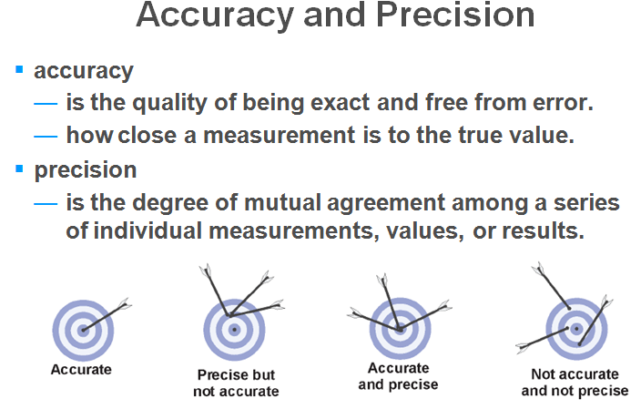
.

Slide 28
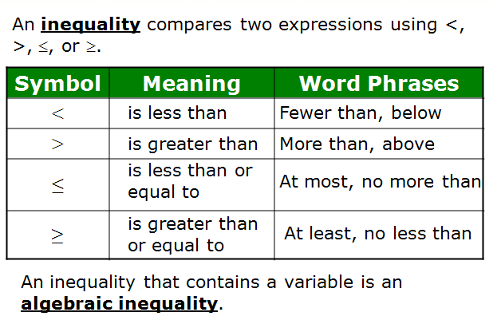
Algebra of Inequalities
CIIT, Attock

Slide 29
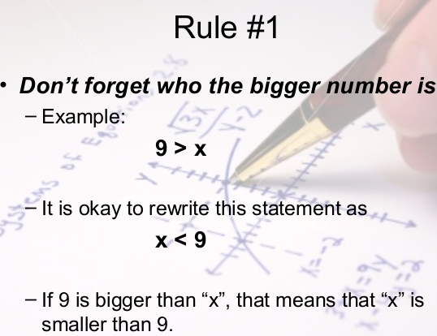
Solving Inequalities
CIIT, Attock

Slide 30
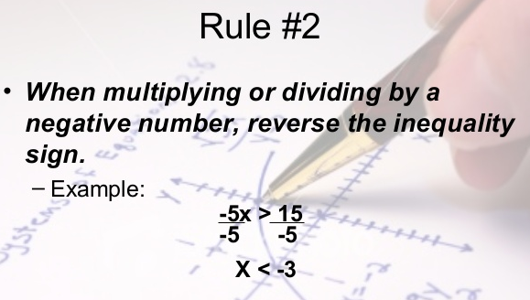
CIIT, Attock

Slide 31
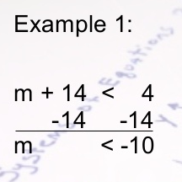
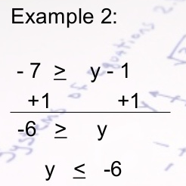
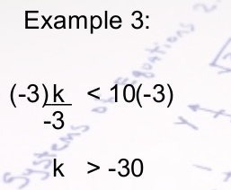
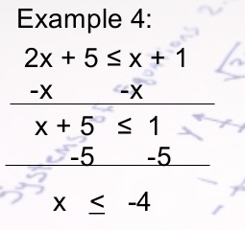
CIIT, Attock

Slide 32
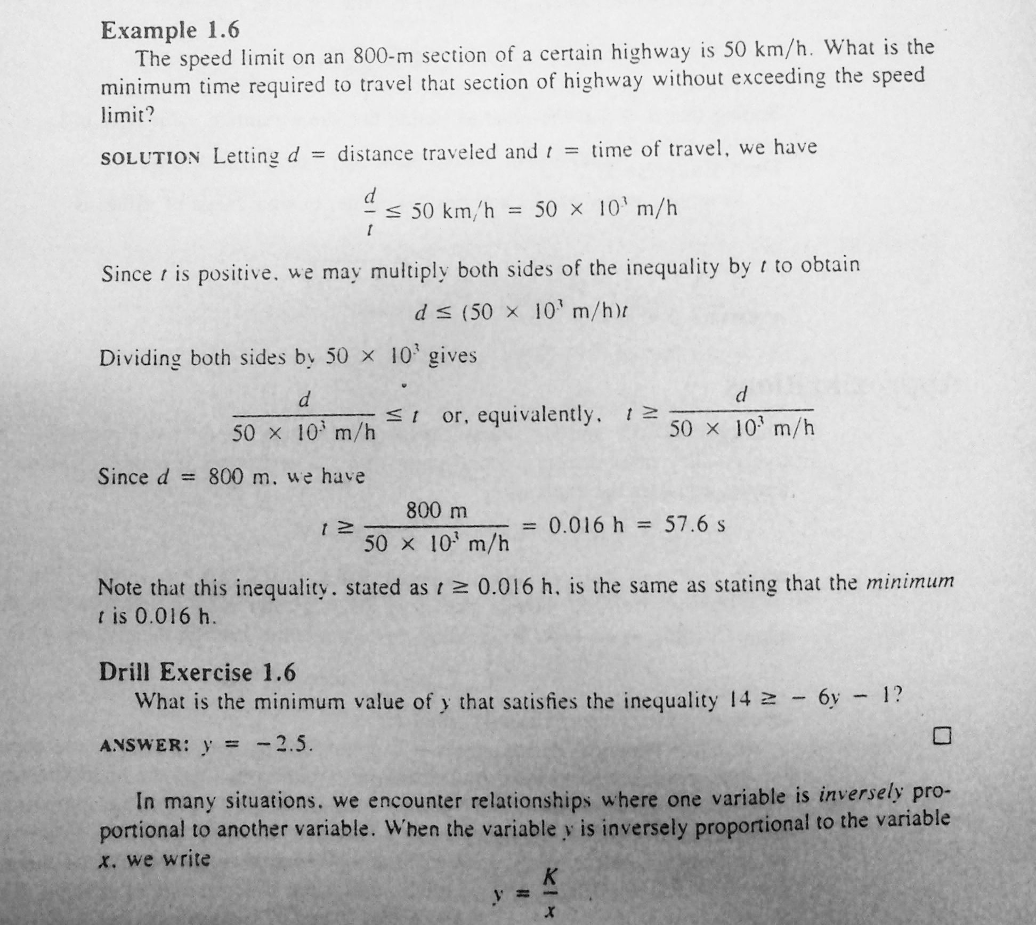
CIIT, Attock

Slide 33
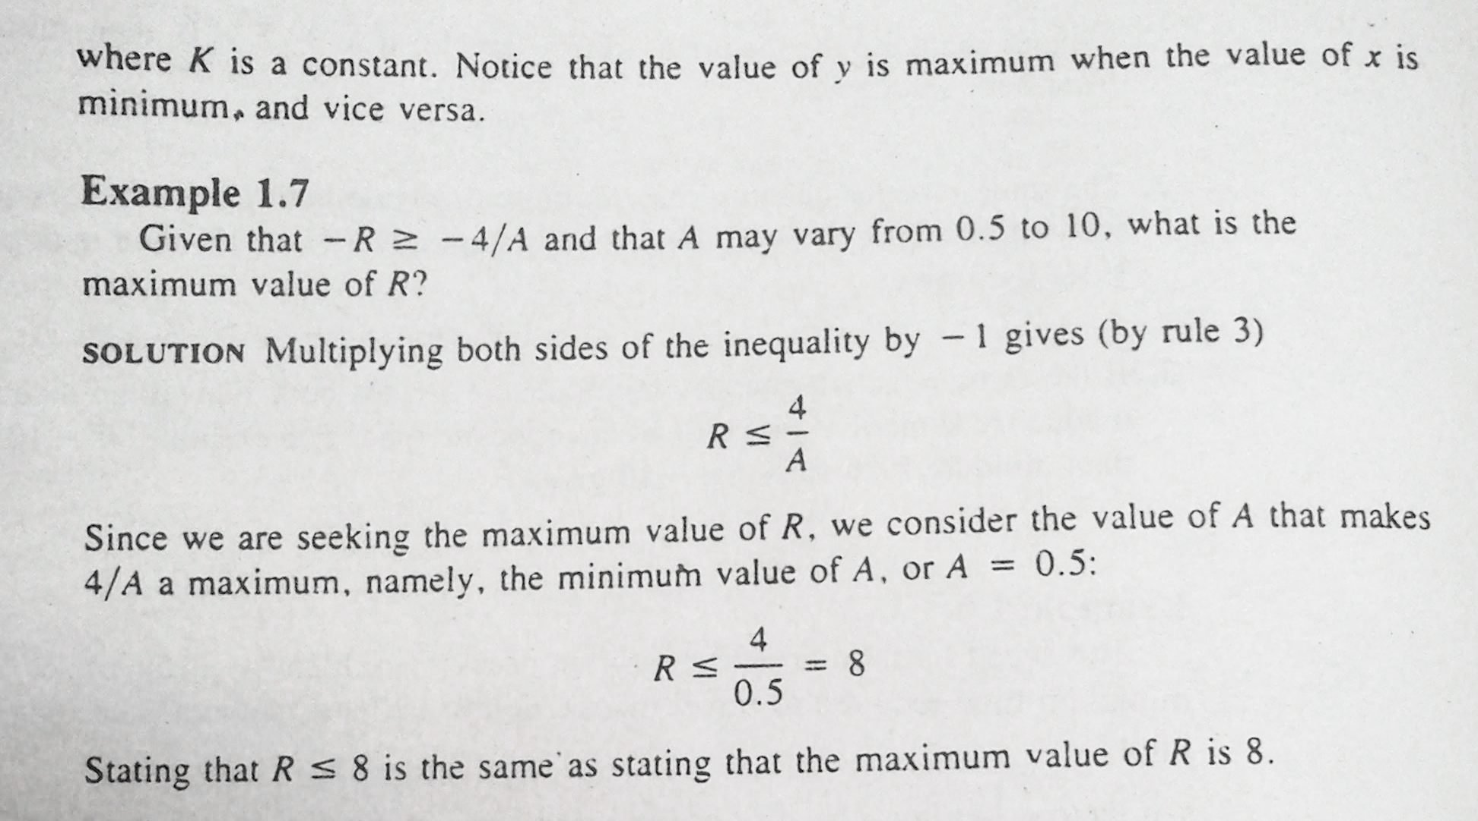
CIIT, Attock

